Slide 1


Mart
18-11-2023

Slide 2

Outline
Executive Summary
Introduction
Methodology
Results
Conclusion
Appendix

Slide 3
Executive Summary
For this project we tackled a couple of problems, of which were:
SpaceX Falcon 9 First Stage Landing Prediction
Using SQL to get information about Launch sites and more
Find more information about Results of the falcon 9 landings, success rates, etc…
Doing some Location analyses with Folium
And doing some landing predictions using sklearn

Slide 4

Introduction
In our quest to harness the power of data science, we encountered a multifaceted challenge: How do we effectively gather, clean, and analyze complex datasets to uncover meaningful insights? T
his journey began with a diverse array of raw data, presenting us with the initial problem of transforming it into a coherent and analyzable format.
Our primary objective was to navigate through this labyrinth of data to answer critical questions and make data-driven decisions, a task that required meticulous data wrangling, innovative analytical approaches, and a keen understanding of the underlying patterns within the data.

Slide 5

Section 1

Slide 6
Methodology
Executive Summary
Data collection methodology:
Data was collected using a REST API call. And SQL queries (scraping).
Perform data wrangling
This data then was converted into a python dataframe
Perform exploratory data analysis (EDA) using visualization and SQL
Perform interactive visual analytics using Folium and Plotly Dash
Perform predictive analysis using classification models
How to build, tune, evaluate classification models

Slide 7
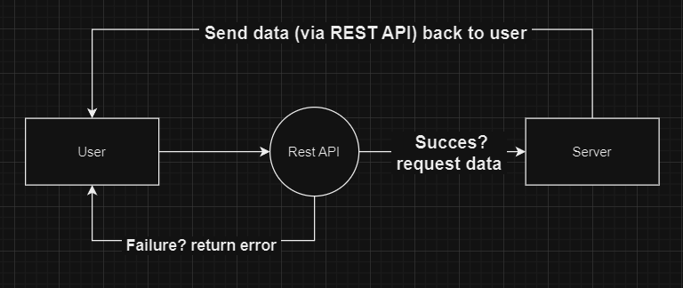
Data Collection – SpaceX API
So REST API calls are used to interact with web services, allowing a client to send a request to a server, which then performs an action (like retrieving data) and returns a response.
The github: https://github.com/KingerNL/Coursera_Data_Science

Slide 8
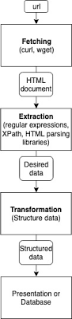
Data Collection - Scraping
SQL queries, on the other hand, are statements used to perform operations on databases, such as retrieving, updating, or deleting data, by directly interacting with the database management system.
The github: https://github.com/KingerNL/Coursera_Data_Science/blob/main/jupyter-labs-eda-sql-coursera_sqllite.ipynb

Slide 9
Data Wrangling
Cleaning, structuring, and enriching raw data into a desired format for better decision making in less time. It involves transforming and mapping data from one "raw" form into another format to make it more appropriate and valuable for a variety of downstream purposes such as analytics.
For the data used in the notebook, I’ve conducted:
Conducted intensive analyses on the data
Removed none entries
2. Created landing outcome label from outcome column
Can be found in the github: https://github.com/KingerNL/Coursera_Data_Science/blob/main/labs-jupyter-spacex-Data%20wrangling.ipynb

Slide 10
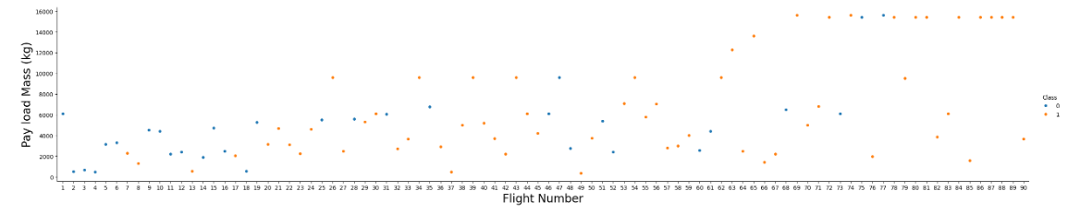
EDA with Data Visualization
I’ve used mostly seaborn, because it gave more overhead and made better plots, I’ve also stuck to trying to compress most the data in a neat graph.
The github page I’ve used: https://github.com/KingerNL/Coursera_Data_Science/blob/main/jupyter-labs-eda-dataviz.ipynb

Slide 11
EDA with SQL
The queries I’ve performed:
Task 1: Distinct
Task 2: Limit
Task 3: Sum
Task 4: Average
Task 5: Minimum
Task 6: Filter
Task 7: Count
Task 8: Maximum
Task 9: Extract
Task 10: Rank
Link to github page: https://github.com/KingerNL/Coursera_Data_Science/blob/main/jupyter-labs-eda-sql-coursera_sqllite.ipynb

Slide 12
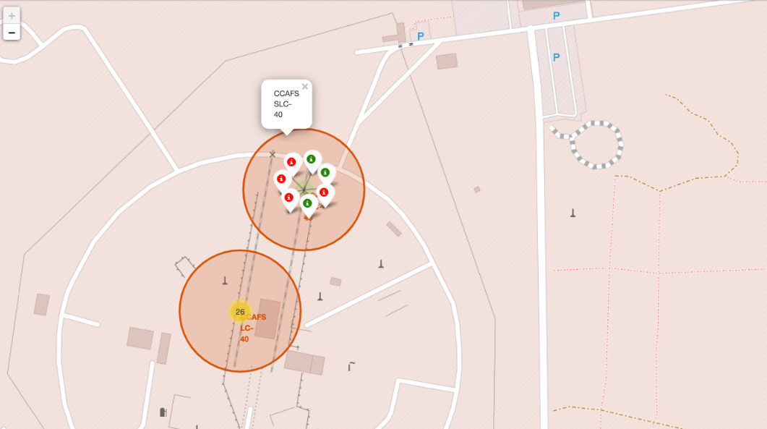
Build an Interactive Map with Folium
The Folium map has objects such as
markers
circles
lines
Link to Github: https://github.com/KingerNL/Coursera_Data_Science/blob/main/lab_jupyter_launch_site_location.ipynb

Slide 13
Build a Dashboard with Plotly Dash
I’ve added a lot of plots for various information
Link to Github: https://github.com/KingerNL/Coursera_Data_Science/blob/main/jupyter-labs-eda-dataviz.ipynb

Slide 14
Predictive Analysis (Classification)
While used the following techniques:
LogisticRegression
GridSearchCV
DecisionTreeClassifier
KNeighborsClassifier
Decision Tree was the best, but more on that later.
Github: https://github.com/KingerNL/Coursera_Data_Science/blob/main/SpaceX_Machine_Learning_Prediction_Part_5.jupyterlite.ipynb

Slide 15

Section 2

Slide 16
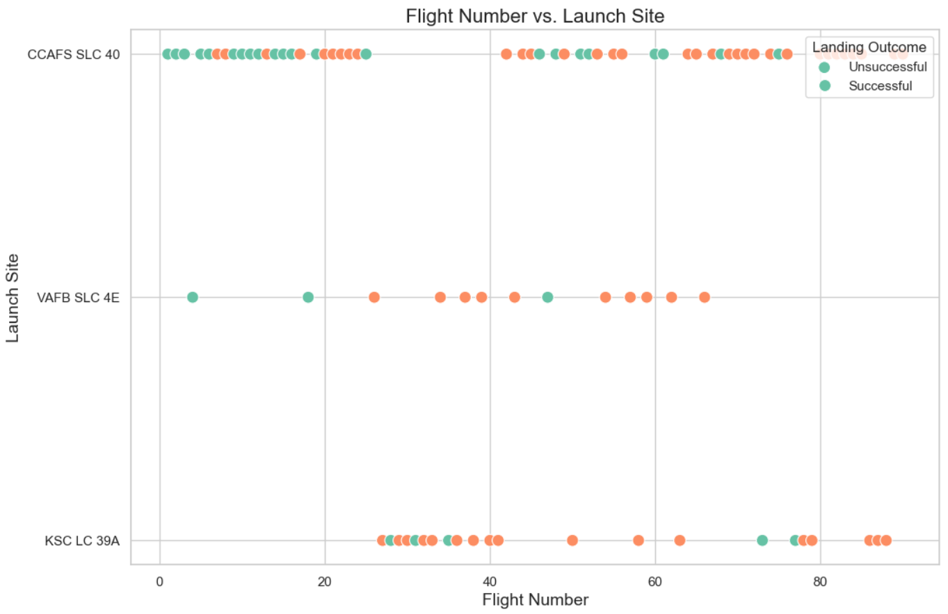
Flight Number vs. Launch Site
This is a seaborn scatterplot for the different launch sites, and the different flight numbers
16

Slide 17
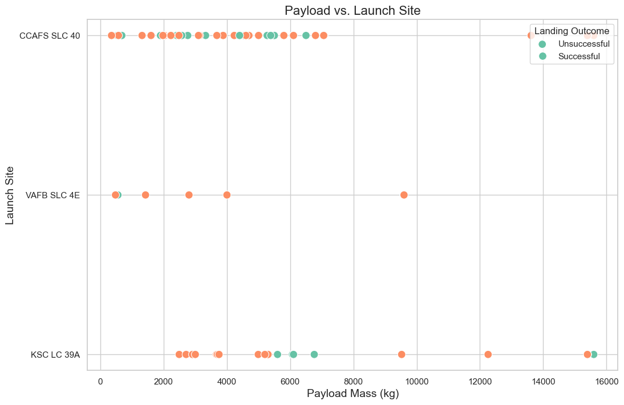
Payload vs. Launch Site
This is a seaborn scatterplot for the different payloads at the different launch sites
17

Slide 18
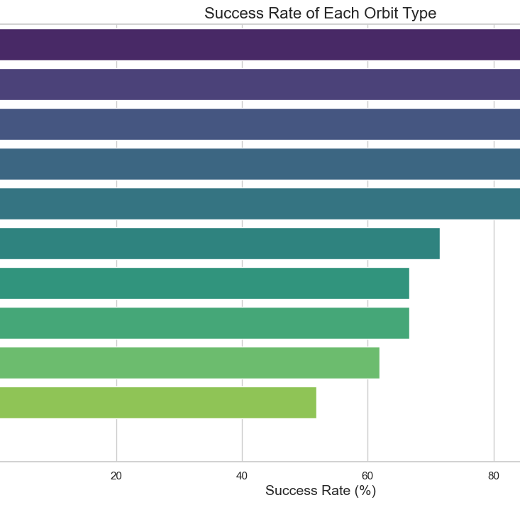
Success Rate vs. Orbit Type
This is the barr scart with success rate for each orbit type

Slide 19
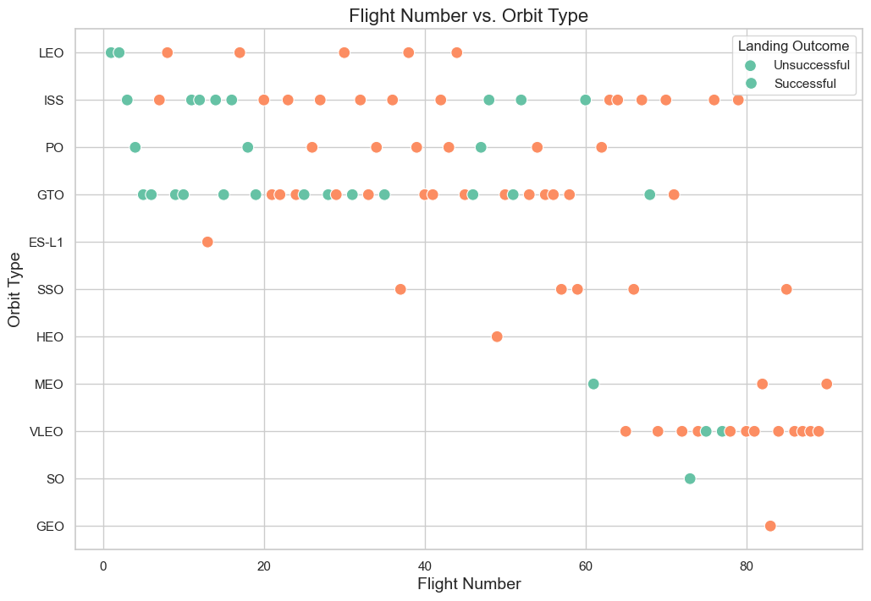
Flight Number vs. Orbit Type
This is the flight number vs orbit type scatter cart.

Slide 20
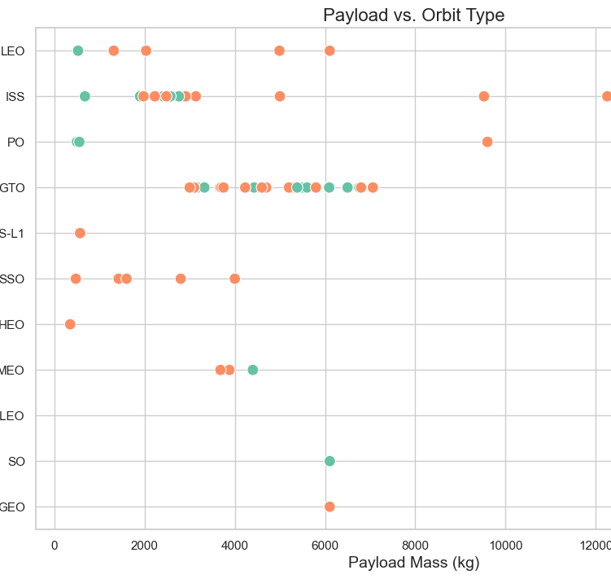
Payload vs. Orbit Type
Here you can see the difference in payload vs orbit type.

Slide 21
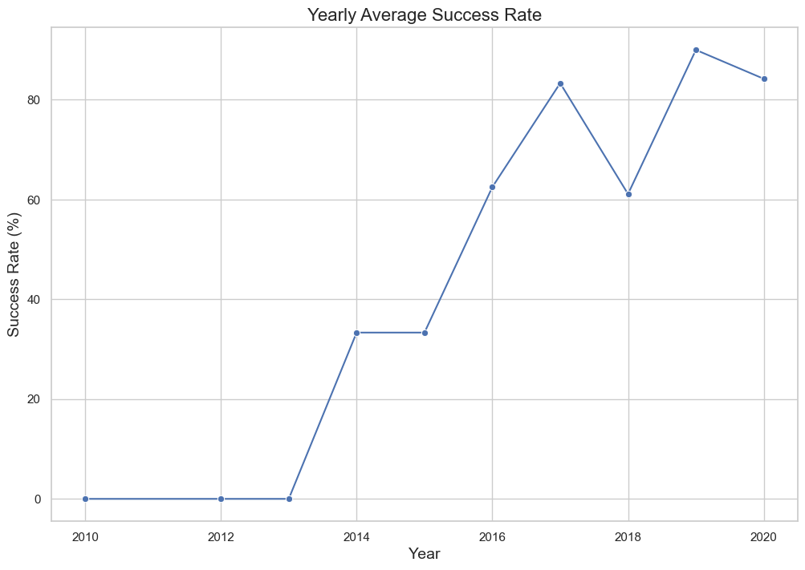
Launch Success Yearly Trend
Here you can see the success rate over the years
You can see clearly that the success rate increased over the span of 4 years by 80%. From 2013 to 2017.

Slide 22
Launch Site Names
CCAFS SLC 40' 'VAFUnique Launch Sites:
0 CCAFS SLC 40
1 CCAFS SLC 40
2 CCAFS SLC 40
3 VAFB SLC 4E
4 CCAFS SLC 40
...
85 KSC LC 39A
86 KSC LC 39A
87 KSC LC 39A
88 CCAFS SLC 40
89 CCAFS SLC 40'
Unique Launch Site Beginning with 'CCA’:
'CCAFS SLC 40'

Slide 23

Section 3

Slide 24
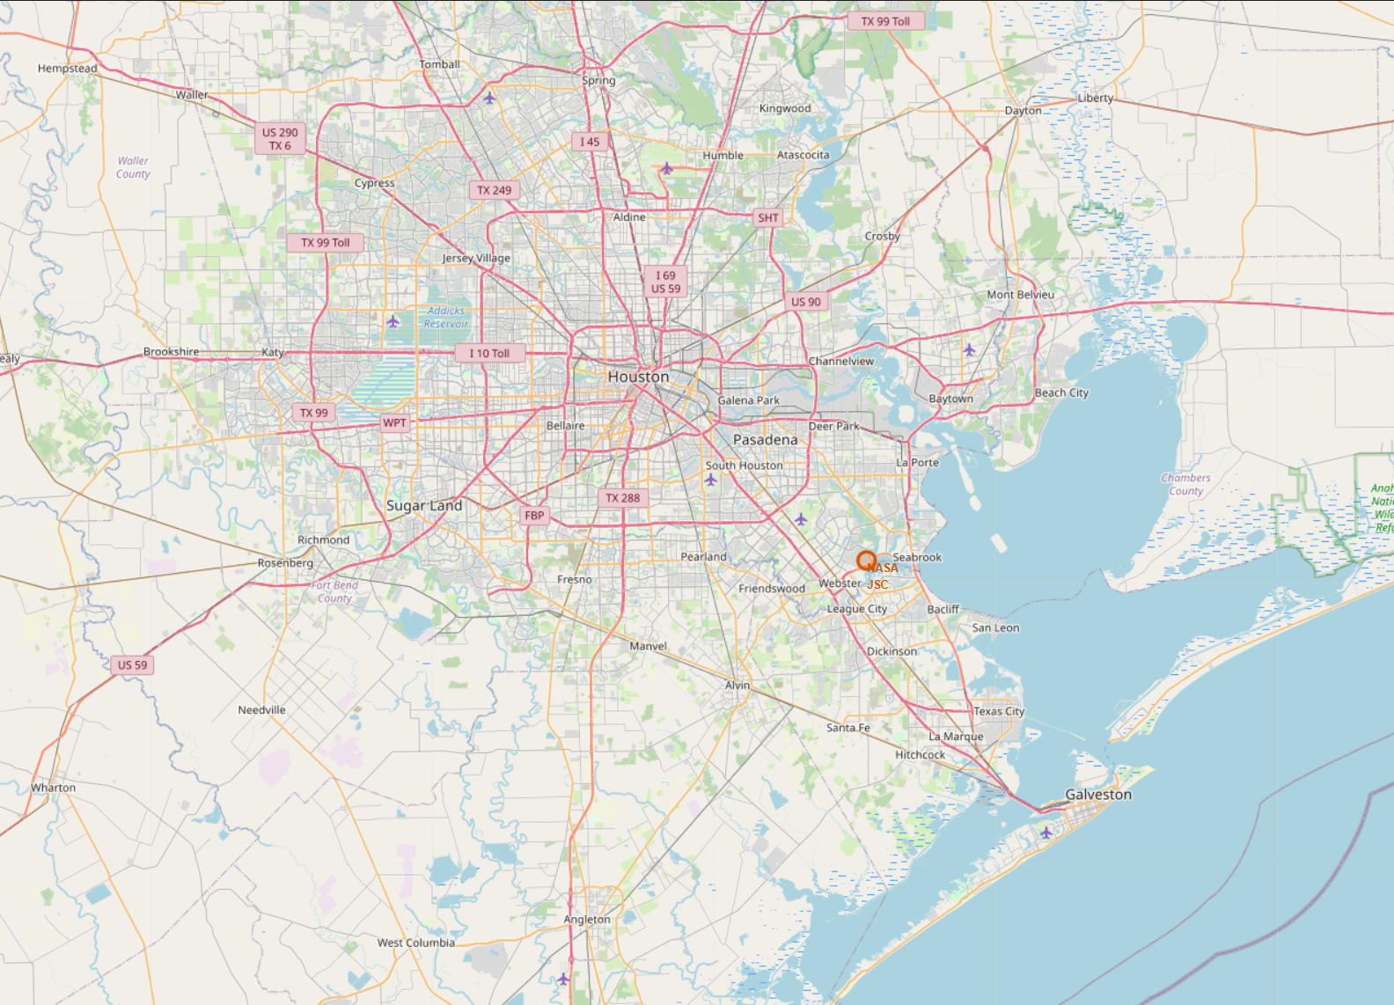
NASA JSC Houston
A screenshot of Houston
This is were NASA JSC is located

Slide 25
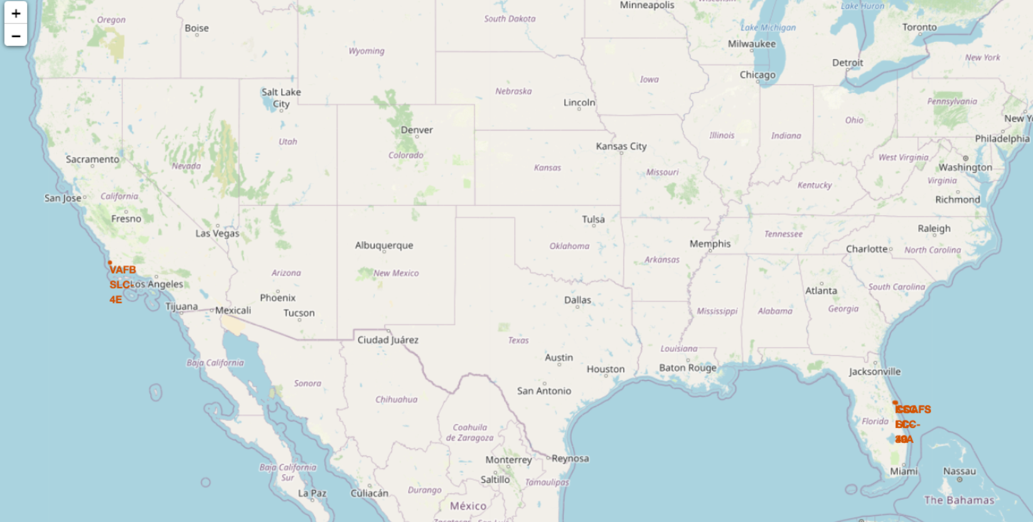
Launch sites
These were some of the launch sites

Slide 26
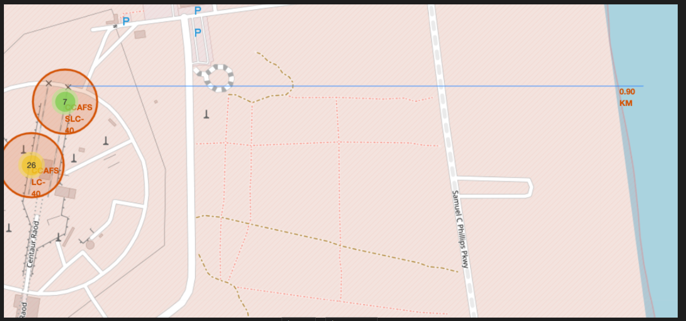
A line photo, from water to launch site
An photo of the updated map with direction line from water to launch site

Slide 27

Section 5

Slide 28
Classification Accuracy
While used the following techniques:
LogisticRegression
GridSearchCV
DecisionTreeClassifier
KNeighborsClassifier
Decision tree had the highest accuracy, with: 86.07 %

Slide 29

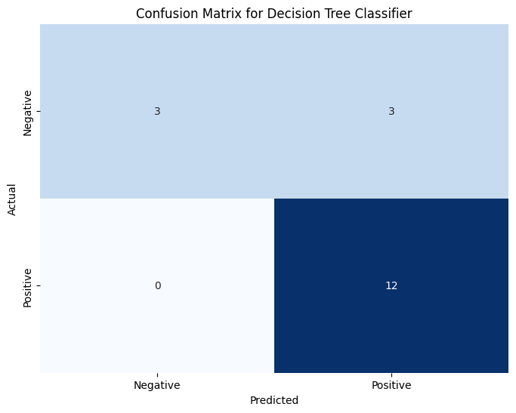
Confusion matrix Decision Tree

Slide 30
Conclusions
The conclusion was that after doing some model tests, the following statements could be made:
Decision tree was the best, followed by;
GridSearchCV and KNeighborsClassifier
At last place we have LogisticRegression, which scored the worst.
For more information you can see the notebook at: https://github.com/KingerNL/Coursera_Data_Science/blob/main/SpaceX_Machine_Learning_Prediction_Part_5.jupyterlite.ipynb

Slide 31


